Slide 1
Jermyn Borough Council Meeting
8/6/20

Slide 2
Meeting Agenda
Call to Order
Pledge of Allegiance
Roll Call
Previous Meeting Minutes
Treasurer’s Report/Bills Payable
Correspondence
Public Comment
Professional Reports
Committee Reports
Borough Manager Report
R&L
Greenways, Trails and Recreation Grant Resolution
Towing
New Business
Adjournment

Slide 3
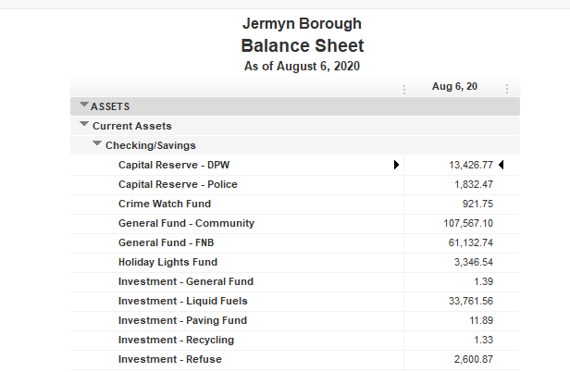
Treasurer’s report

Slide 4
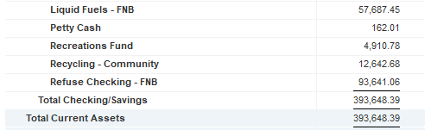
Treasurer’s report

Slide 5

Treasurer’s report

Slide 6
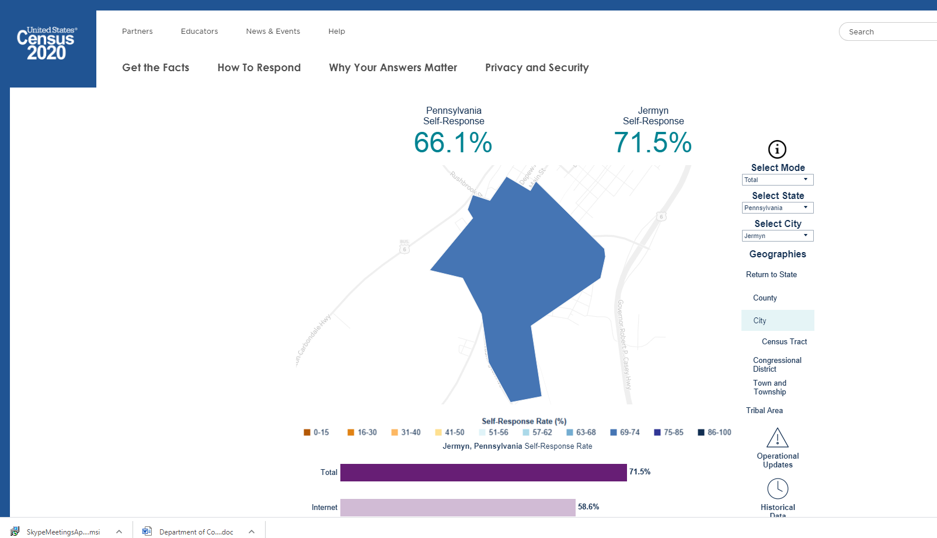

Slide 7


